Slide 1
Case Study: Youtube Link for Alexandra Thibeaux’s Presentation
Alex Thibeaux
athibeaux@smu.edu
Nicholas Mueller
nmueller111@yahoo.com

Slide 2



Missing Values
IBU 1005
ABV 62
Multivariate Imputation Via Changed Equation (mice)
Notes:
##Talking points:
###With the help of the Multivariate Imputation via Chained Equation(mice) we are able to use a method called “Fully Conditional Specification”(FCS) to help fill the missing IBU values.
###We are able to create a model for each missing variable based on the observed data and other observed variables in the dataset
### PMM predictive mean matching
###Also referred to as a type of regression modeling.

Slide 3
##Talking points:
###With the help of the Multivariate Imputation via Chained Equation(mice) we are able to use a method called “Fully Conditional Specification”(FCS) to help fill the missing IBU values.
###We are able to create a model for each missing variable based on the observed data and other observed variables in the dataset
### PMM predictive mean matching
###Also referred to as a type of regression modeling.

Slide 4
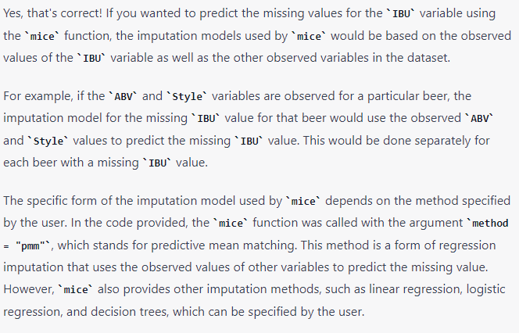

Slide 5

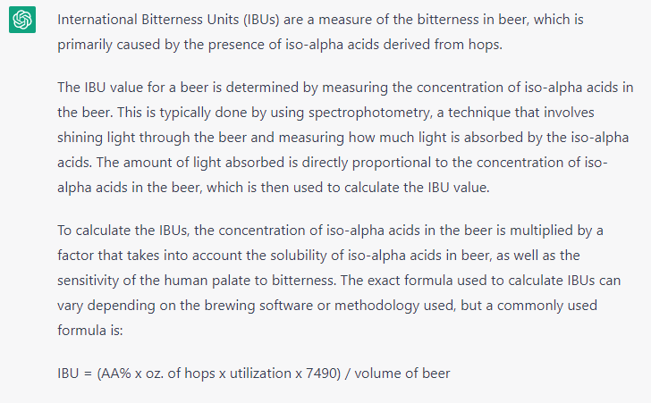
Notes:
International Bitterness Units (IBUs) are a measure of the bitterness in beer, which is primarily caused by the presence of iso-alpha acids derived from hops.
The IBU value for a beer is determined by measuring the concentration of iso-alpha acids in the beer. This is typically done by using spectrophotometry, a technique that involves shining light through the beer and measuring how much light is absorbed by the iso-alpha acids. The amount of light absorbed is directly proportional to the concentration of iso-alpha acids in the beer, which is then used to calculate the IBU value.
To calculate the IBUs, the concentration of iso-alpha acids in the beer is multiplied by a factor that takes into account the solubility of iso-alpha acids in beer, as well as the sensitivity of the human palate to bitterness. The exact formula used to calculate IBUs can vary depending on the brewing software or methodology used, but a commonly used formula is:
IBU = (AA% x oz. of hops x utilization x 7490) / volume of beer
where AA% is the alpha acid percentage of the hops, oz. of hops is the weight of the hops used in ounces, utilization is the percentage of alpha acids that are actually isomerized during the boiling process, and 7490 is a constant used to convert the result to IBUs. The volume of beer is typically measured in gallons or liters.
It's worth noting that IBUs are not a perfect measure of bitterness perception in beer, as the human palate can be influenced by a variety of factors such as sweetness, acidity, and carbonation. Nonetheless, IBUs remain a useful tool for brewers and beer enthusiasts to measure and compare the perceived bitterness of different beers.

Slide 6
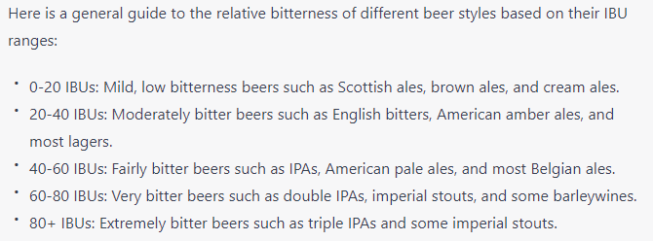
MAR: The probability of missing may depend on the covariates but are MCAR within those subgroups. The probability of missingness does not depend on the value of IBU but is dependent / related to the values of a covariate. In other words, they are MCAR within the subgroups of the covariate.

Slide 7
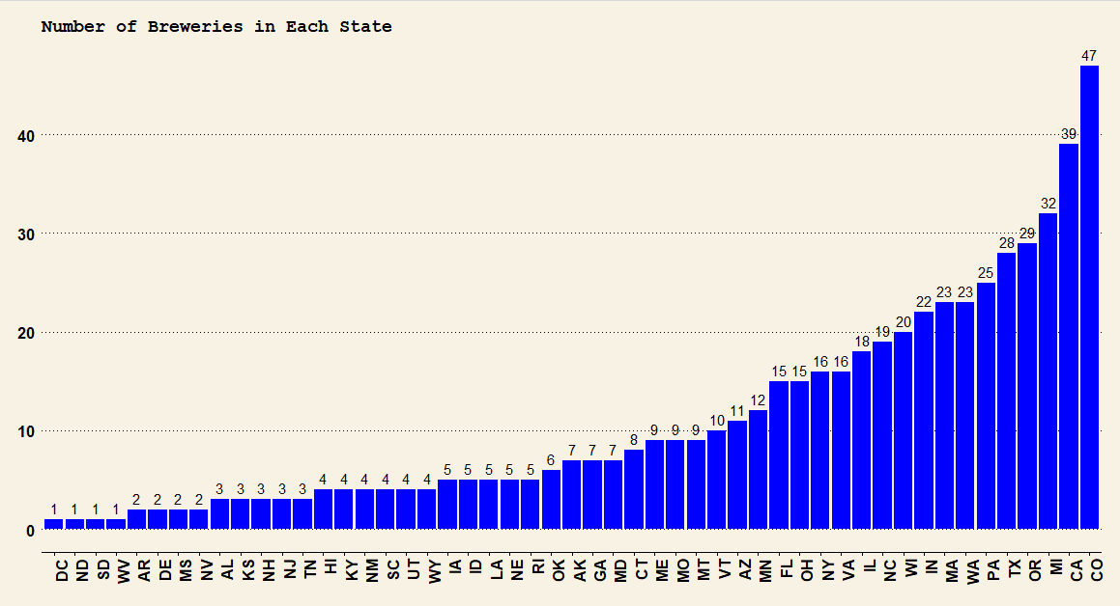
Number of Breweries Per State
1.Colorado
2.California
3.Maine
4.Oregon
5.Texas
6.Pennsylvania
7. Washington
8.Massachusetts
9.Indiana
10.Wisconsin
Number of Breweries
State

Slide 8
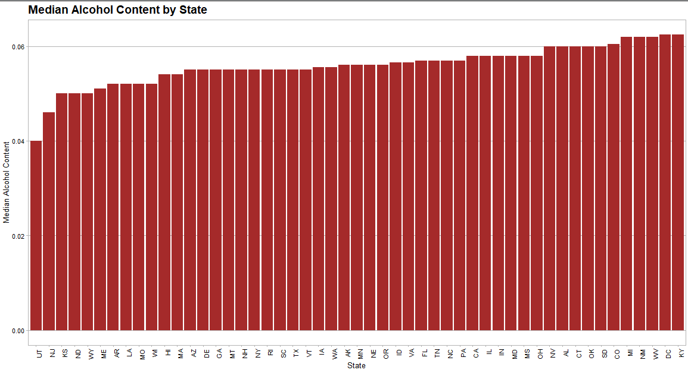
Computed Median Alcohol Content

Slide 9
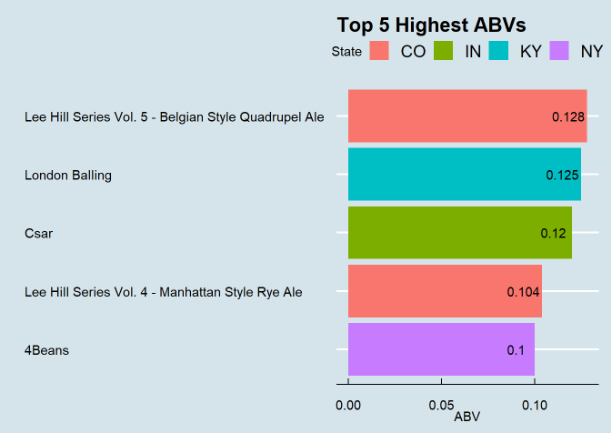
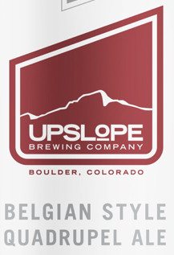
State With The Maximum Alcoholic (ABV) Beer

Slide 10
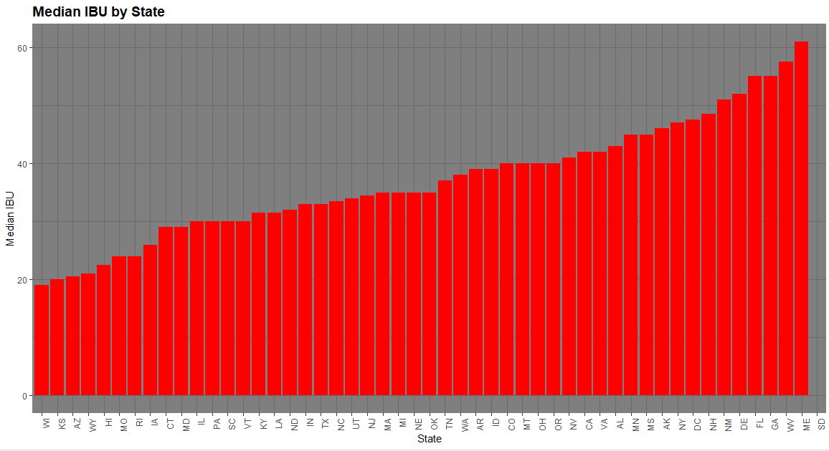
Computed International Bitterness Unit For Each State
Maine
West Virginia
Georgia
Florida
Delaware
New Mexico
New Hampshire
Washington D.C
New York
Arkansas
No Value

Slide 11
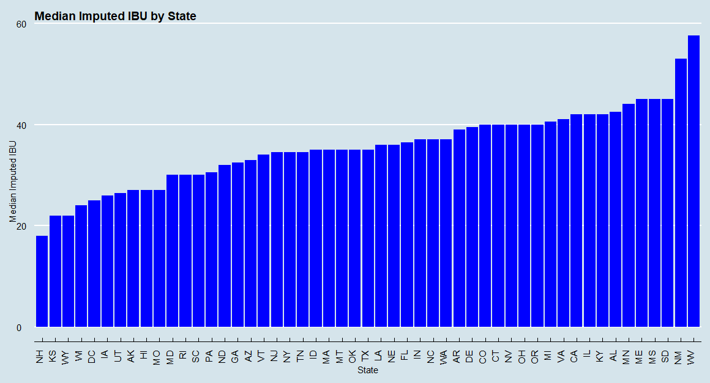
Imputed IBU For Each State
West Virginia
New Mexico
South Dakota
Mississippi
Maine
Minnesota
Alabama
Kentucky
Illinois
California

Slide 12
Imputed data vs. non-imputed data IBU For Each State
No Value

Slide 13
Top 5 Imputed vs Non-Imputed
Rank | Imputed States | Non-Imputed States
1 | West Virginia | Maine
2 | New Mexico | West Virginia
3 | South Dakota | Georgia
4 | Mississippi | Florida
5 | Maine | Delaware

Slide 14
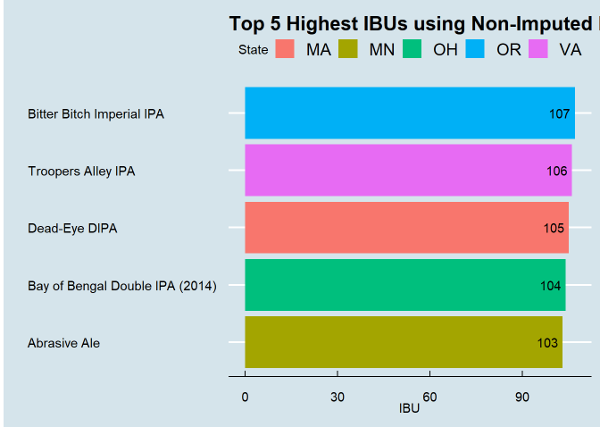

State With The Most Bitter (IBU) Beer

Slide 15

State With The Most Bitter (IBU) Beer

Slide 16
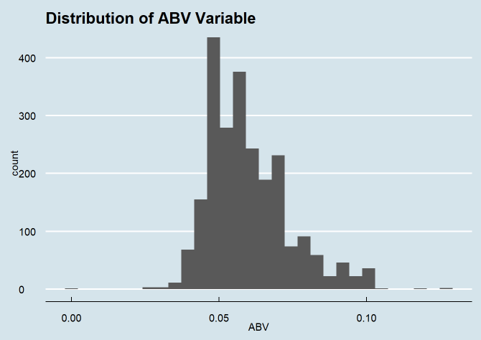
Summary statistics and distribution of the ABV variable.
Minimum: 0.1%
1st Quintile: 5.0%
Median: 5.6%
Mean: 5.97%
3rd Quintile: 5.97%
Max: 12.8%

Slide 17
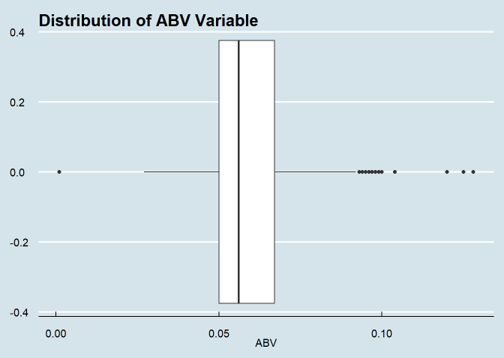
Summary statistics and distribution of the ABV variable.
Minimum: 0.1%
1st Quintile: 5.0%
Median: 5.6%
Mean: 5.97%
3rd Quintile: 5.97%
Max: 12.8%

Slide 18
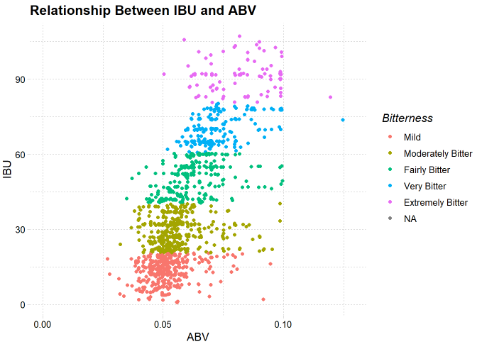
The relationship between the bitterness of the beer and its alcoholic content:

Slide 19
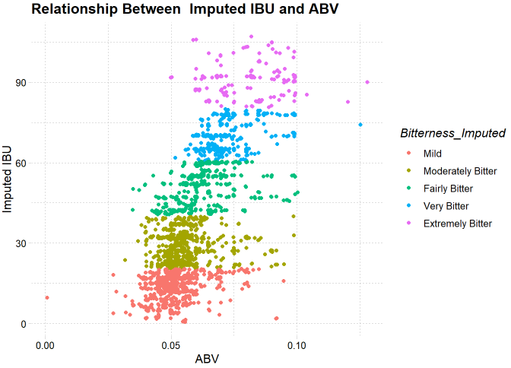
The relationship between the bitterness of the beer and its alcoholic content:
With Imputed Data.

Slide 20
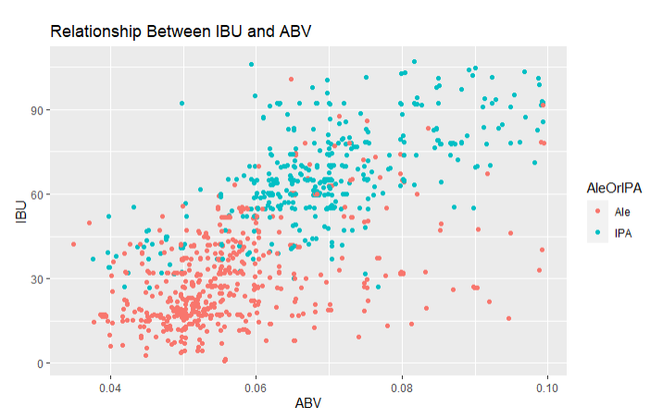
Showing The Relationship With K-Nearest-Neighbor
Tests | Range in Percent
Accuracy | 80%-90%
Sensitivity | 80%-90%
Specificity | 75%-85%
K=30

Slide 21
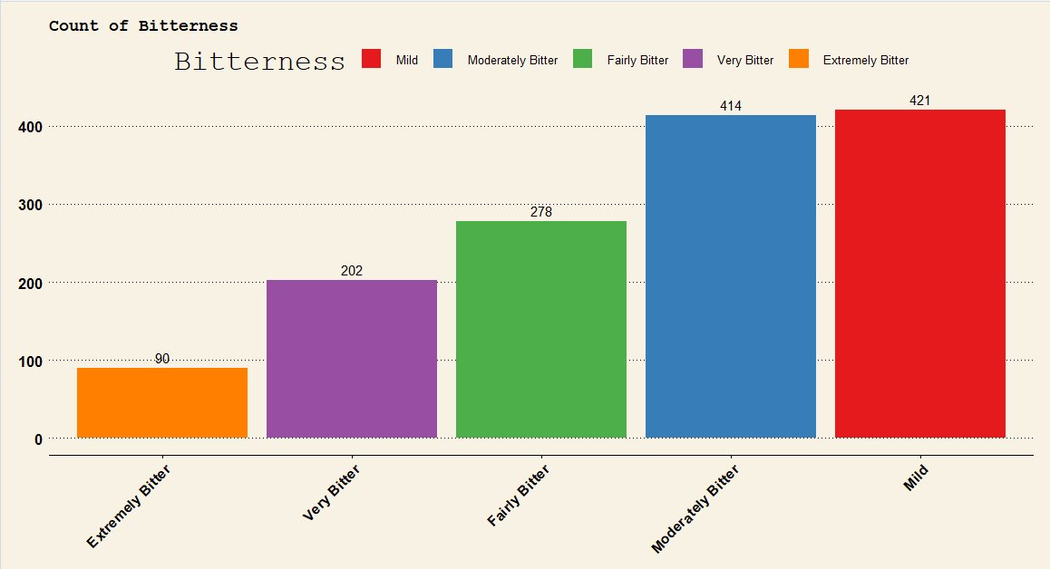
Extra Fun!
Mild: 30%
Moderately Bitter: 29%
Fairly Bitter: 20%
Very Bitter: 14%
Extremely Bitter: 6%
Number of Beers

Slide 22
Questions?
Alex Thibeaux
athibeaux@smu.edu
Nicholas Mueller
nmueller111@yahoo.com

Slide 23
Questions?

